Slide 1
Fall 2023 Data Science Bootcamp Titanic Project
Alex Gutierrez, Gary Wu, Shubh Kamdar

Slide 2
BACKGROUND

Slide 3
BACKGROUND: Introduction
Total Onboard:
2224 people were onboard the Titanic
Survival Stats:
Unfortunately, 1502 people did not survive the Titanic Incident
Dataset:
Dataset encompasses information on 891 passengers.
Columns include PassengerId, Survived, Pclass, Name, Sex, Age, SibSp, Parch, Ticket, Fare, Cabin, Embarked

Slide 4
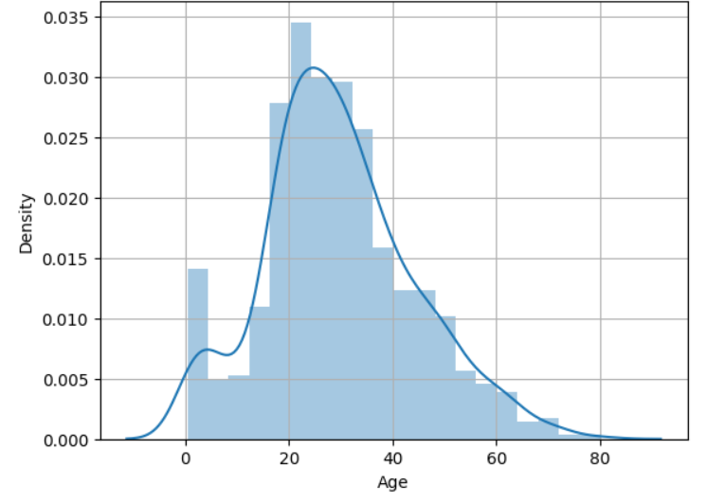
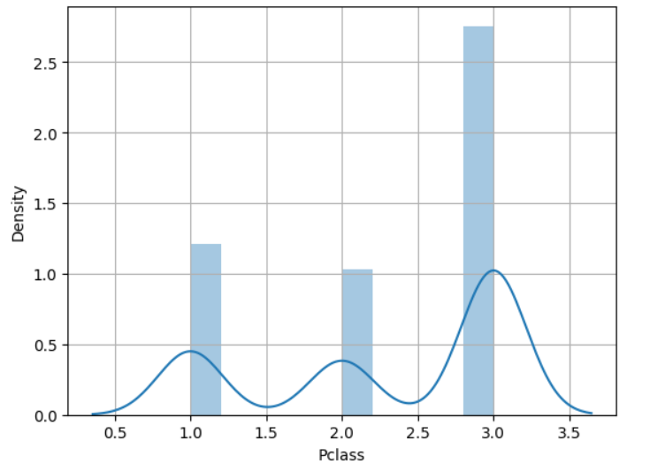
BACKGROUND: Demographics and Variables

Slide 5
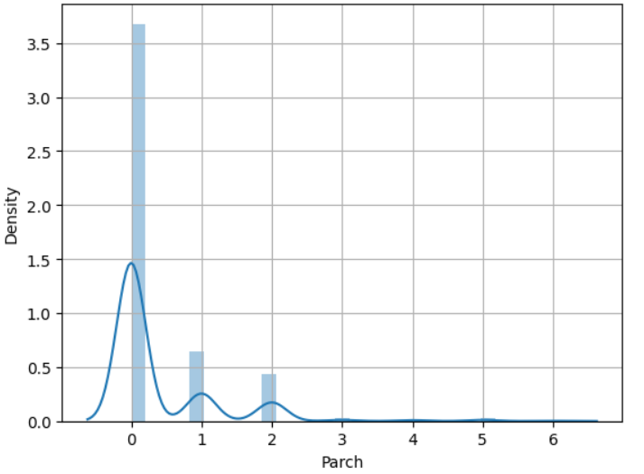
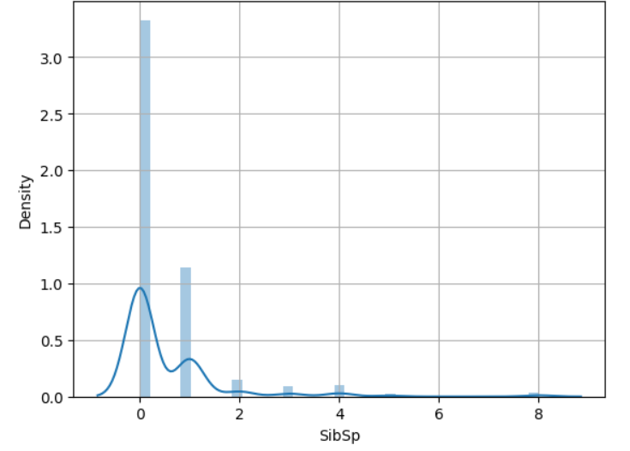
BACKGROUND: Demographics and Variables
Parents/Children
Siblings/Spouse

Slide 6
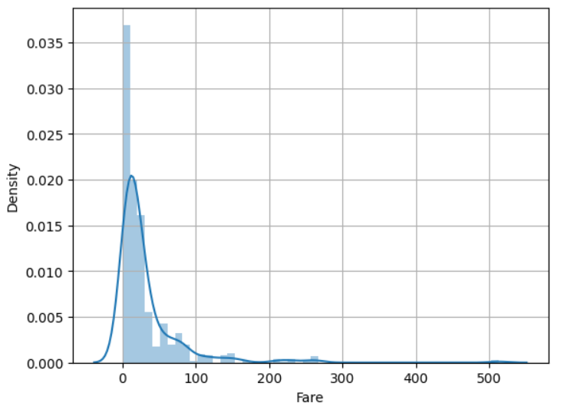
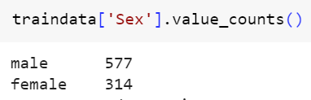
BACKGROUND: Demographics and Variables

Slide 7
RESEARCH QUESTIONS

Slide 8
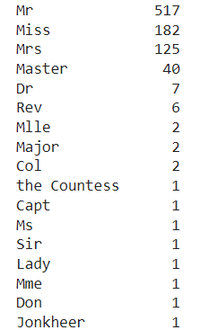
RESEARCH QUESTIONS: Exploring Nomenclature
Relevance of Names:
How do names, last names, and prefixes/titles relate to survival?
Investigate potential correlations between nomenclature and Titanic survival rates.

Slide 9
RESEARCH QUESTIONS: Data Integrity & Survival Factors
Handling Missing Values:
Identify and address null values in the dataset.
Evaluate the impact of missing data on survival outcomes.
Column Relevance:
Assess the importance of each dataset column in our analysis.
Determine whether specific characters within columns contribute significantly to our understanding.
Survival Determinants:
Investigate key features influencing survival outcomes.
Uncover the factors that significantly contribute to an individual's likelihood of surviving the Titanic incident.

Slide 10
METHODOLOGY
Notes:
gary

Slide 11
METHODOLOGY: Overview
Data Exploration:
Dive into a comprehensive exploration of the dataset.
Uncover key patterns, distributions, and potential insights that inform subsequent steps.
Feature Engineering:
Craft and refine features to enhance model performance.
Create new variables, transform existing ones, and optimize the dataset for predictive modeling.
Data Cleaning:
Address missing values, outliers, and other data inconsistencies.
Ensure data integrity and prepare a refined dataset for modeling.
Machine Learning Model Selection:
Identify suitable machine learning models based on the nature of the problem.
Consider the strengths and weaknesses of different algorithms for optimal model performance.
Notes:
gary

Slide 12
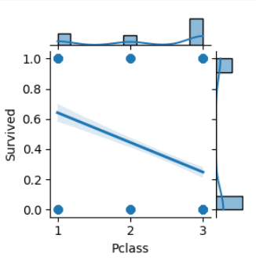
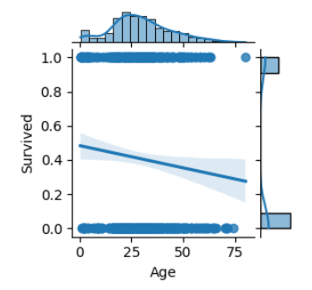
METHODOLOGY: Data Exploration
Notes:
gary

Slide 13
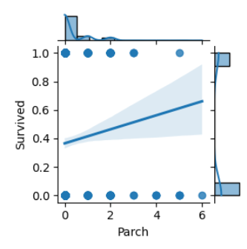
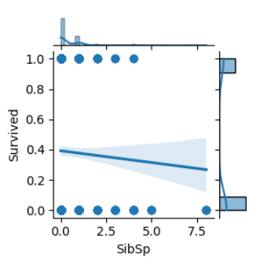
METHODOLOGY: Data Exploration
Notes:
gary

Slide 14
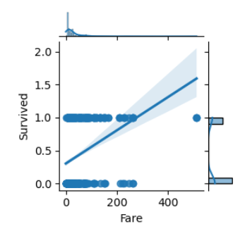
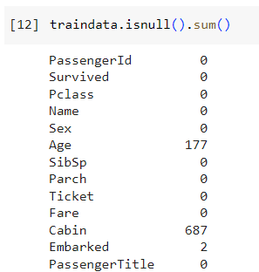
METHODOLOGY: Data Exploration
Notes:
gary

Slide 15
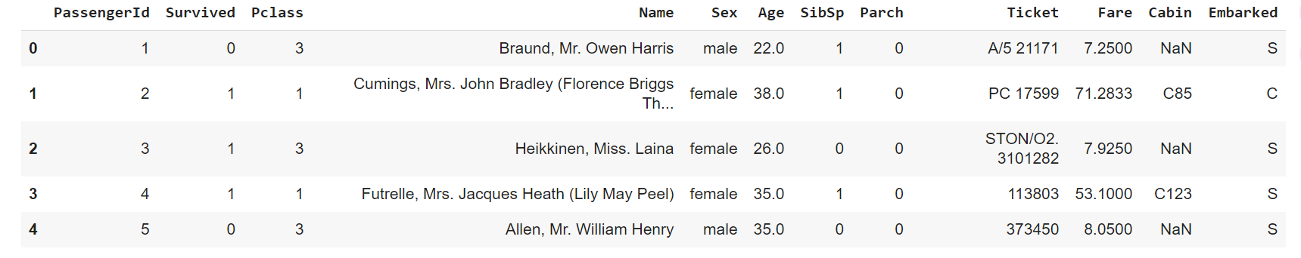
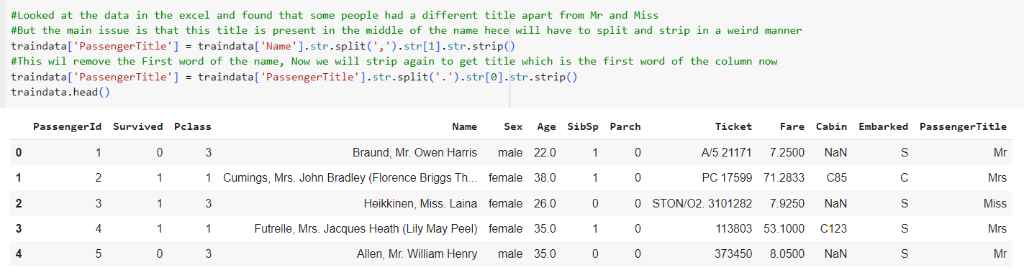
METHODOLOGY: Title Feature Engineering

Slide 16
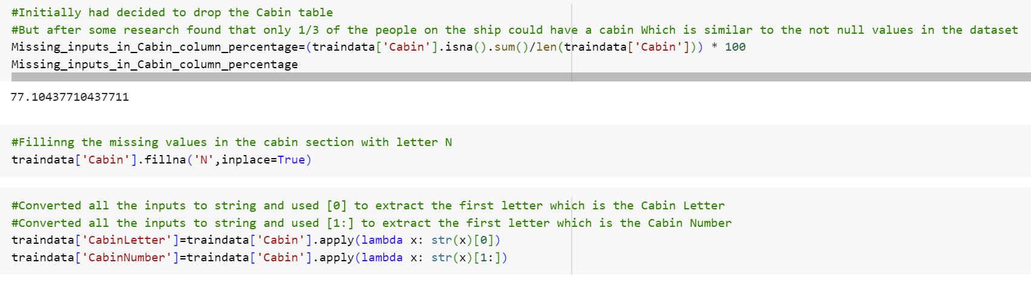
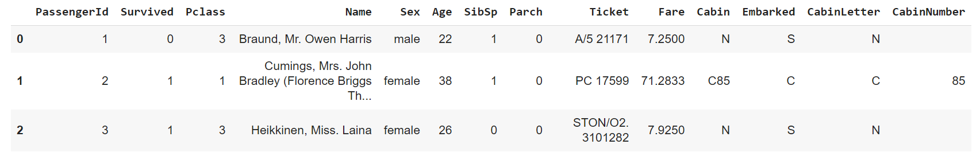
METHODOLOGY: Cabin Feature Engineering

Slide 17
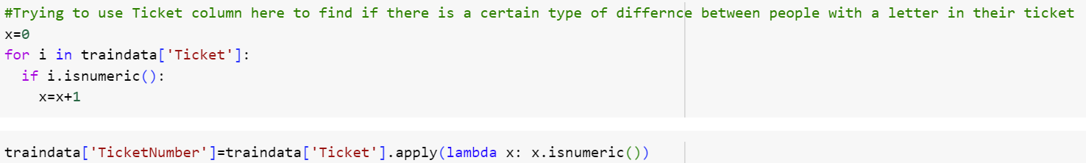
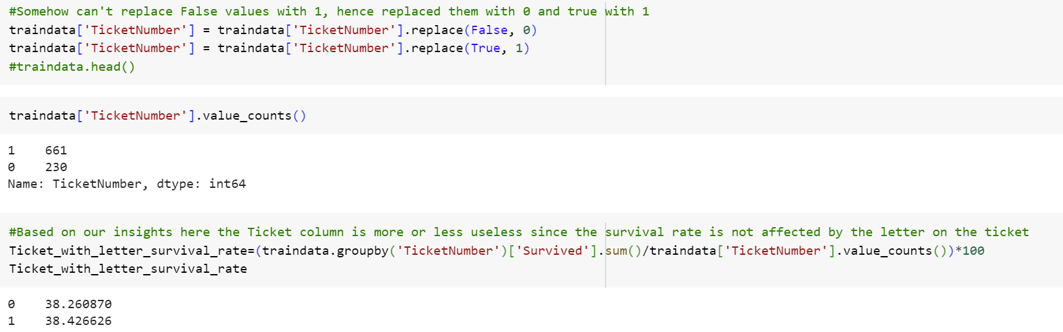
METHODOLOGY: Ticket Number Feature Engineering

Slide 18
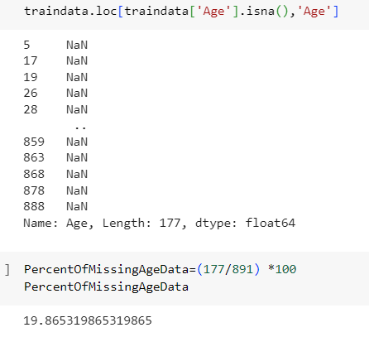
METHODOLOGY: Data Cleaning - Age
Identify the missing values within the column.
Understand the scope of the data gaps for informed decision-making.
Examine the ratio of null values to valid entries and evaluate the significance
Determine whether dropping null values is appropriate or if imputation is the preferred strategy.
Explore potential values to insert, ensuring they align with the dataset's characteristics.

Slide 19
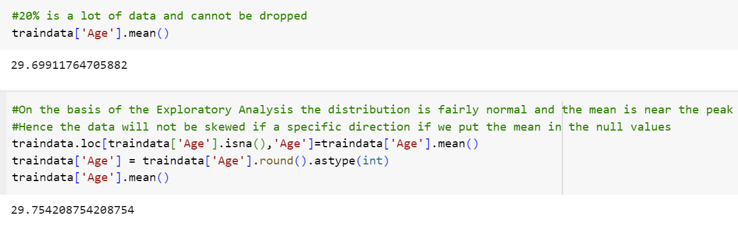
METHODOLOGY: Data Cleaning - Age

Slide 20
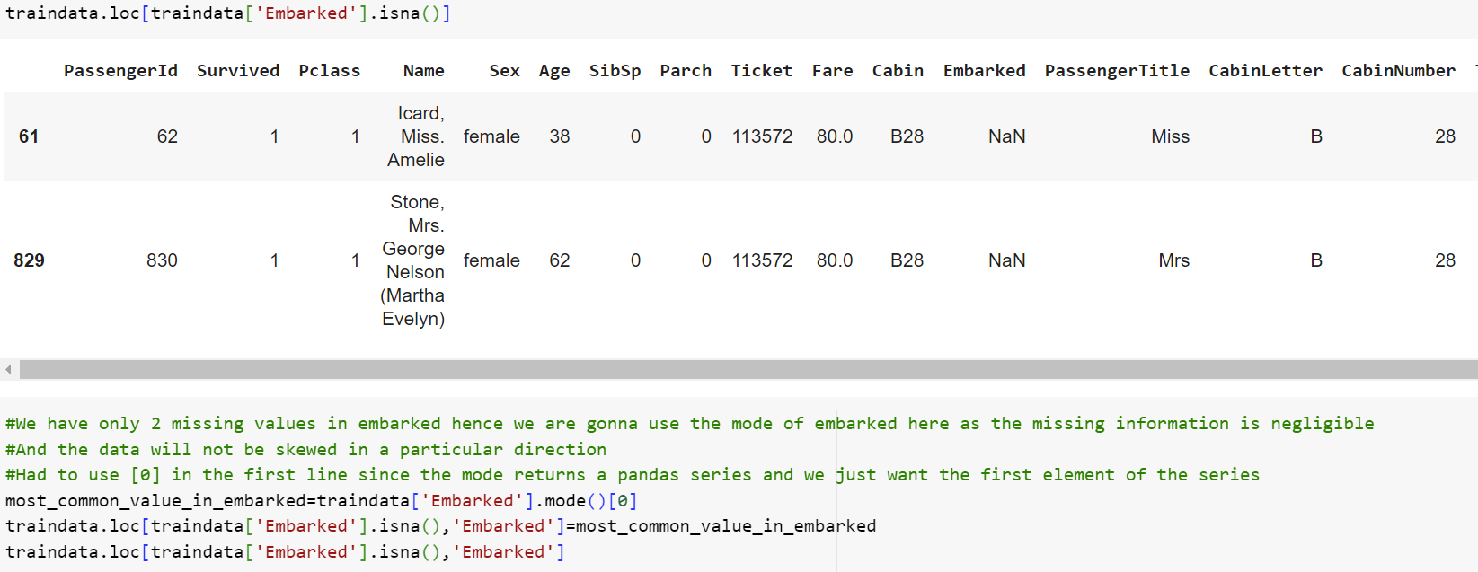
METHODOLOGY: Data Cleaning - Embarked

Slide 21
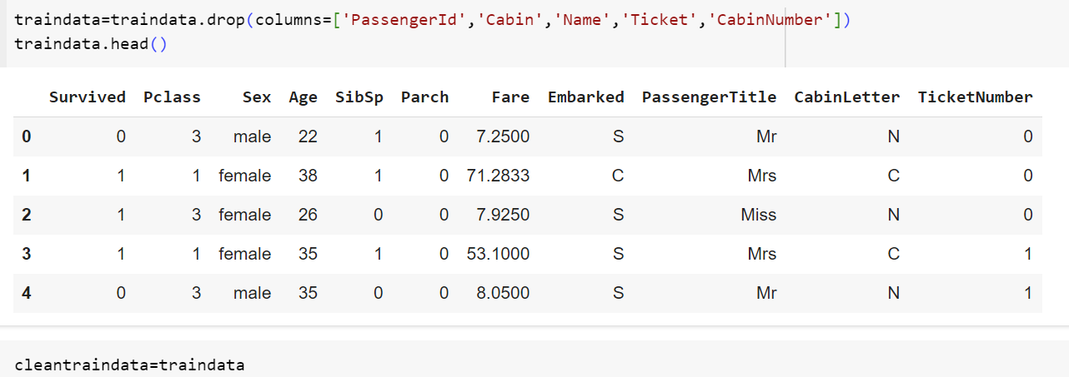
METHODOLOGY: Data Cleaning - Final Dataset

Slide 22
METHODOLOGY: Data Cleaning - Comparison

Slide 23
MACHINE LEARNING MODELS

Slide 24
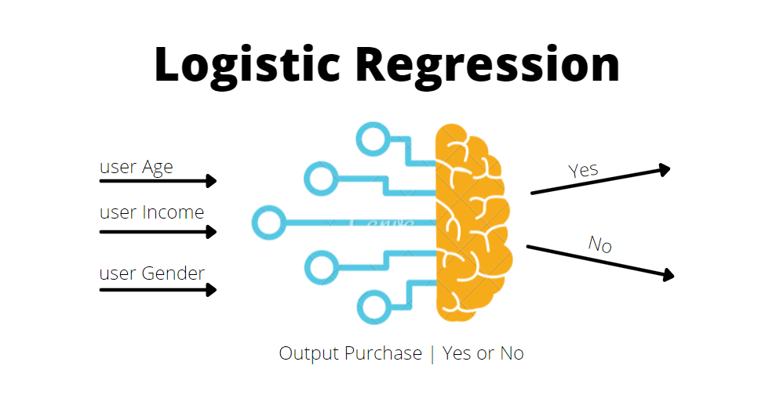
ML MODEL: Logistic Regression
Logistic Regression is a statistical method used for binary classification problems, where the outcome variable is categorical and has two classes.
Logistic Regression models the probability that a given instance belongs to a particular class.
It uses the logistic function (sigmoid function) to squash the output between 0 and 1.
Logistic Regression is a powerful and widely used algorithm for binary classification tasks due to its simplicity and interpretability.

Slide 25
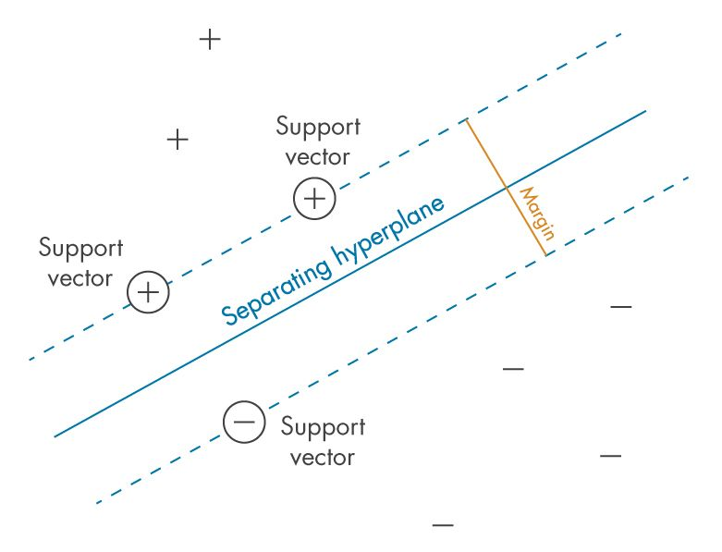
ML MODEL: Support Vector Machine
Supervised learning model versatile for classification and regression tasks
Effective in high-dimensional spaces
Handles non-linear decision boundaries through kernel functions.

Slide 26
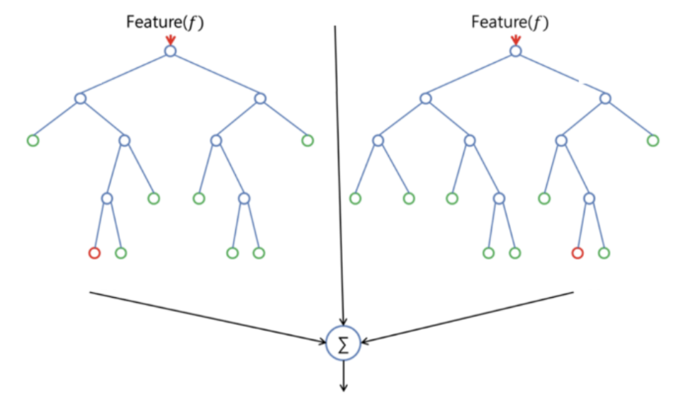
ML MODEL: Random Forest
A supervised learning algorithm which builds an ensemble of decision trees
Can be used for both classification and regression problems
Searches for the best feature among a random subset of features
A random subset of the features is taken into consideration by the algorithm for splitting a node
A wide diversity that generally results in a better model
Random Forest in Classification
Notes:
Put simply: random forest builds multiple decision trees and merges them together to get a more accurate and stable prediction.
RANDOM FOREST ADVANTAGES
Versatile uses
Easy-to-understand hyperparameters
Classifier doesn't overfit with enough trees
RANDOM FOREST DISADVANTAGES
Increased accuracy requires more trees
More trees slow down model
Can’t describe relationships within data

Slide 27
Encoding
Converting text categorical values to numeric values:
Sex: convert features which contain strings to numerical values
Title: convert the categorical titles to ordinal.
Embarked:
Converting numerical continuous feature to ordinal numbers:
Age: create age bands and determine correlations with Survived then replace age with ordinals based on these bands
Fare: same for the fare
Correcting: drop features with lack of data inputs and less important
PassengerID
Ticket Numbers
Etc
Notes:
converting text categorical values to numeric values.

Slide 28
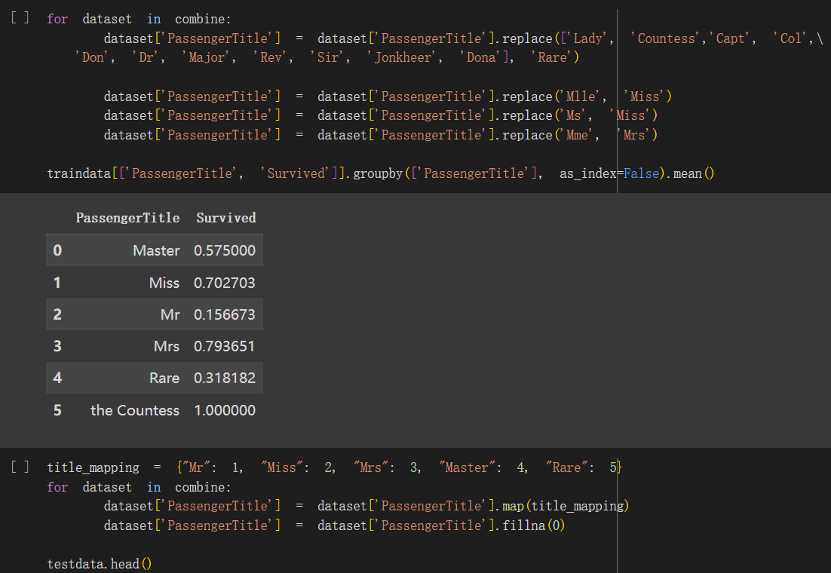
Example: title

Slide 29
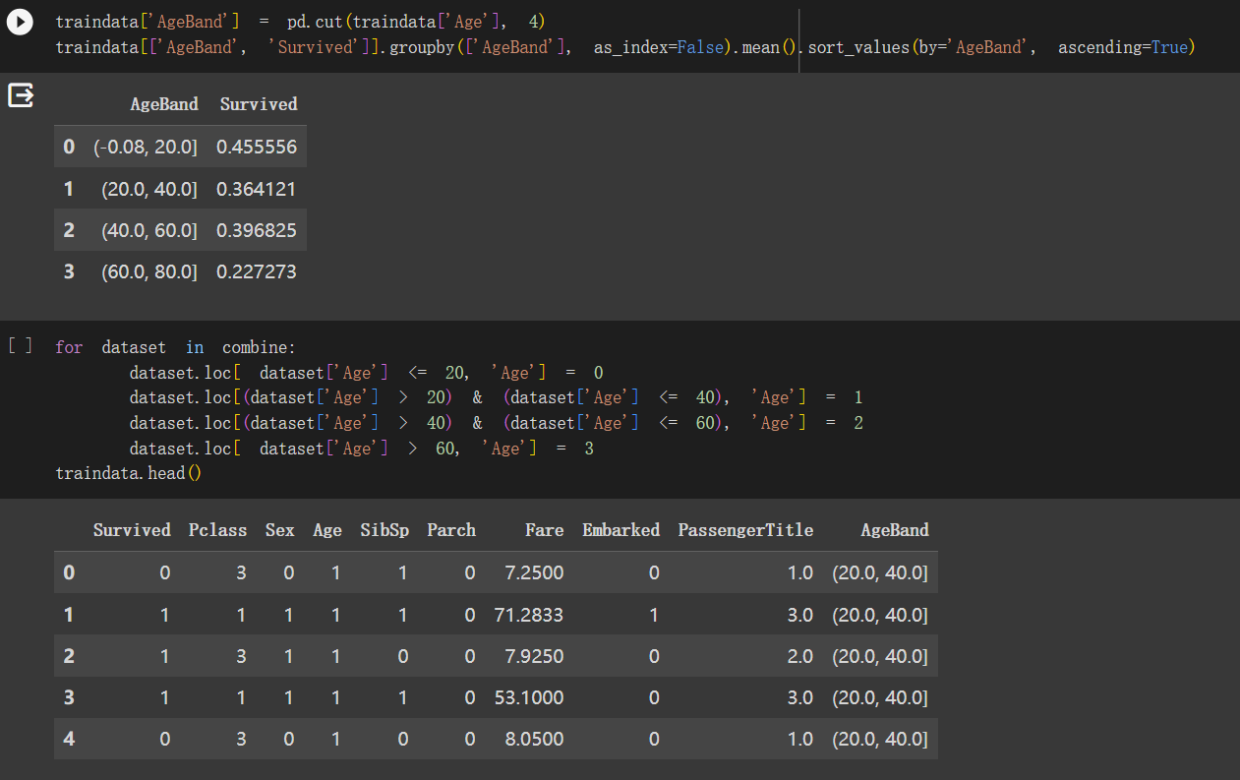
Example: age

Slide 30
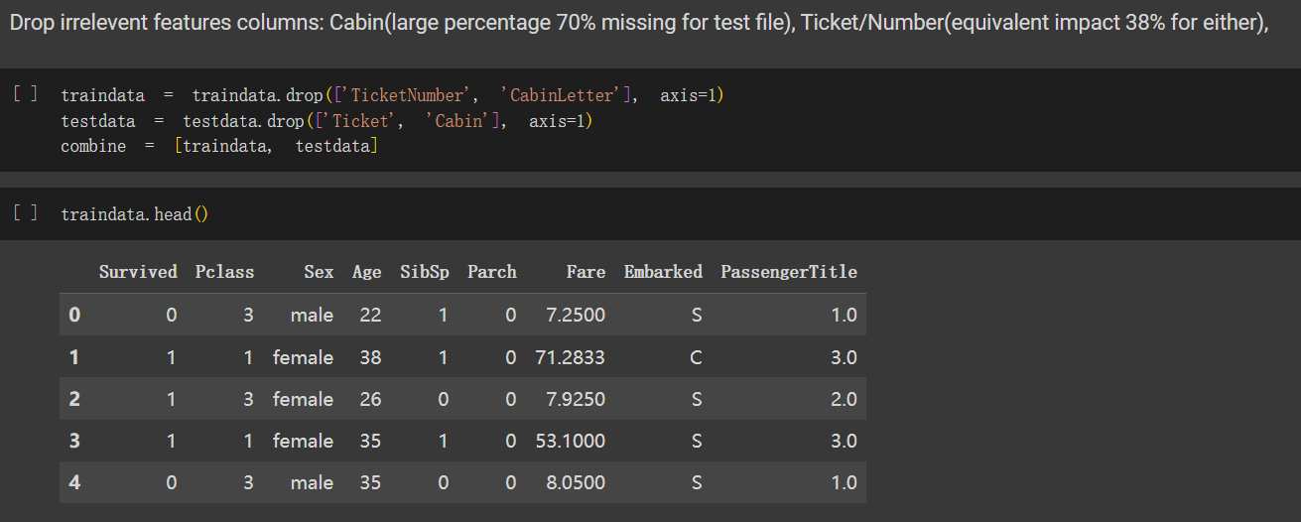
Example: drop “irrelevant” features

Slide 31
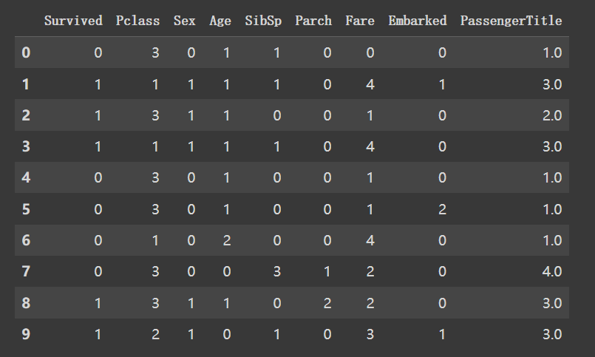
Cleaned dataset:

Slide 32
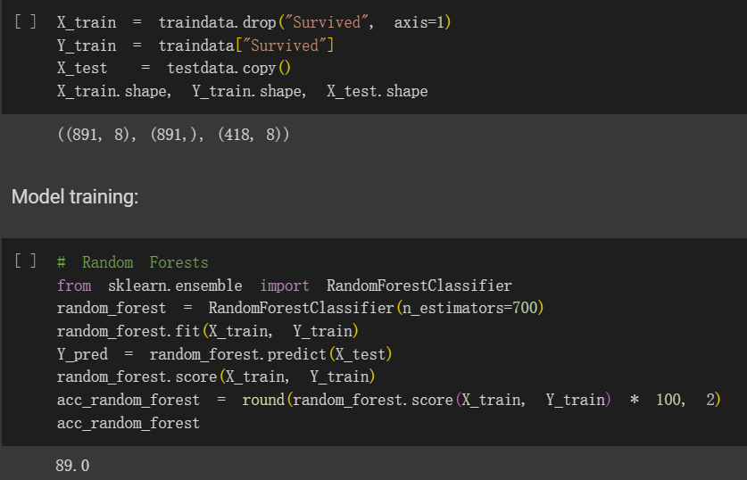
ML-Random Forest

Slide 33
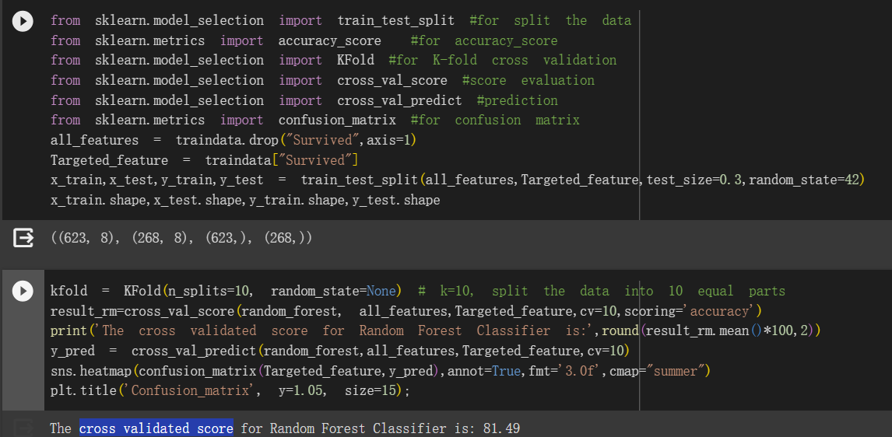
Cross validated score evaluation:

Slide 34
RESULTS

Slide 35
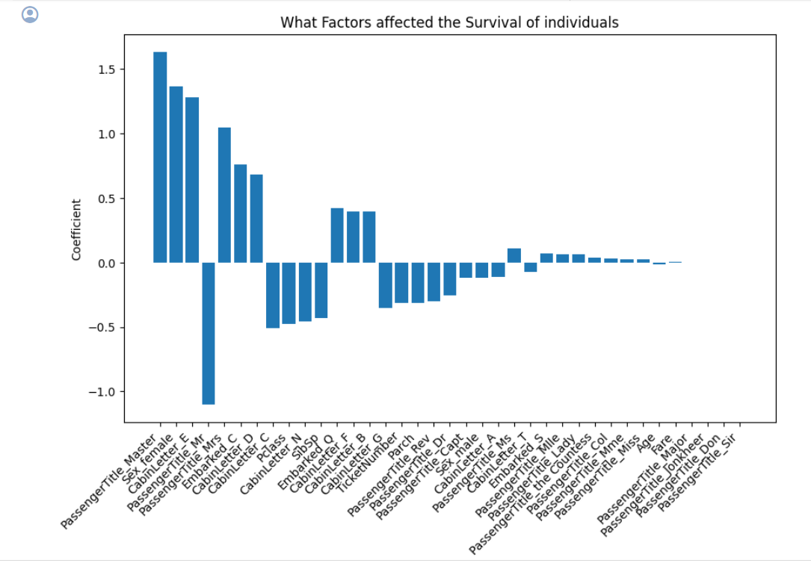
RESULTS: Logistic Regression Key Findings

Slide 36
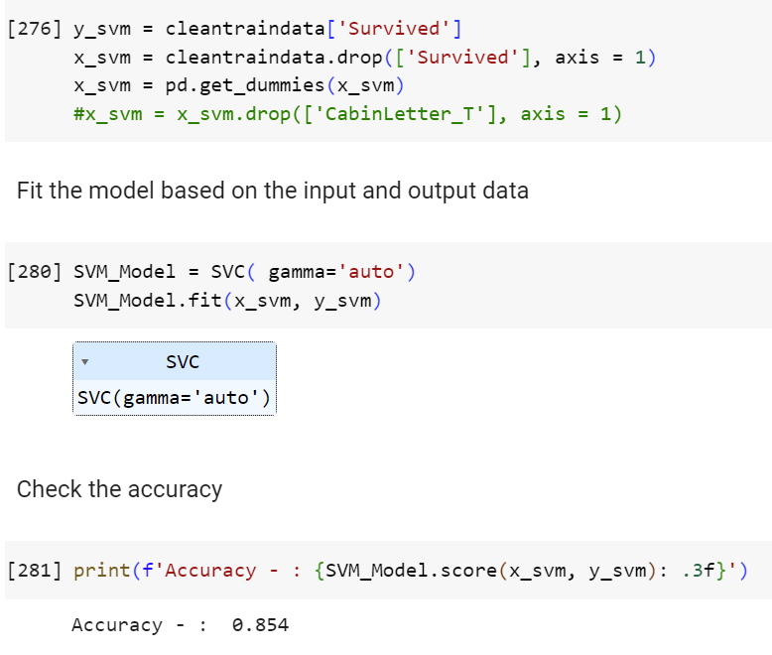
RESULTS: Support Vector Machine Key Findings

Slide 37
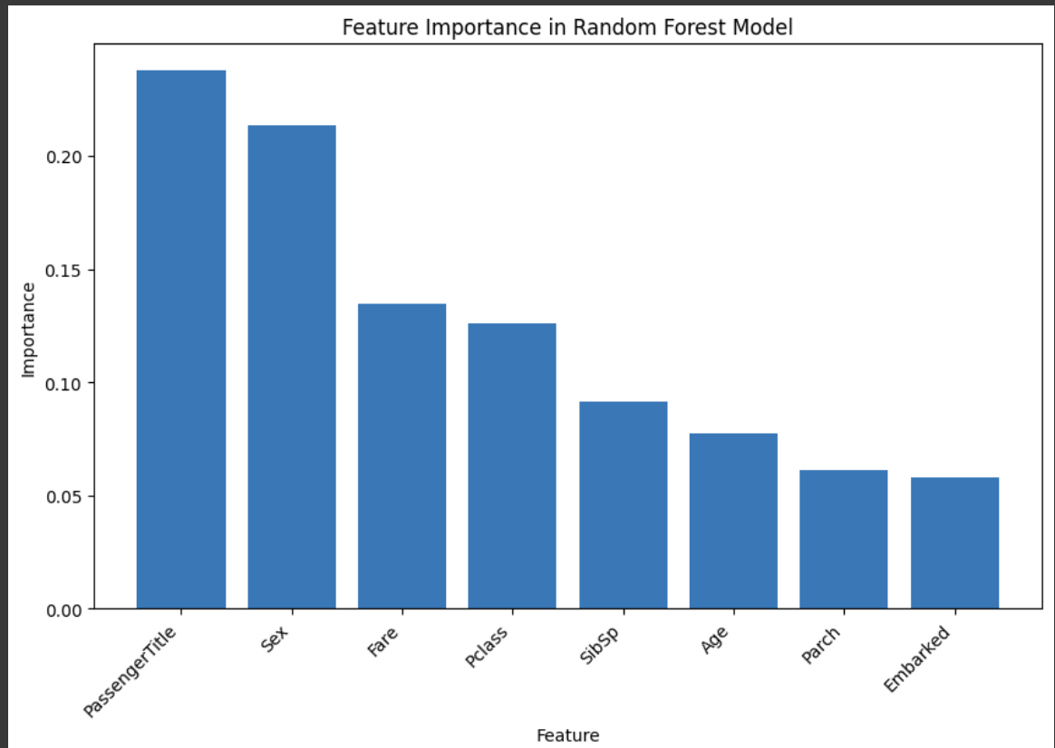
RESULTS: Random Forest Key Findings

Slide 38
CONCLUSION

Slide 39
CONCLUSION: Summary
Logistic Regression:
Achieved an accuracy of 83.05%.
Effective in capturing coefficient and feature relationship.
Support Vector Machine (SVM):
Achieved an accuracy of 85.4%.
Showcased robust performance, particularly in complex decision spaces.
Random Forest:
Exhibited a solid accuracy of 81.49%.
Effective in capturing feature importance

Slide 40
CONCLUSION: Limitations & Challenges
Faced difficulties using the cabin column as a survival in cases where the cabin was the point of impact.
Uncertainties emerged on how to leverage passenger names beyond extracting titles.
Encountered challenges in effectively utilizing passenger ticket numbers.
Certain machine learning models primarily serve as predictive tools and might not inherently describe relationships within the data.
SVM's feature importance function only applicable to linear kernels.
Recognized the challenge of visualizing decision surfaces in high-dimensional spaces.

Slide 41
CONCLUSION: Future Work
Explore hyperparameter tuning for machine learning models to enhance predictive accuracy and experiment with different algorithms
Dive deeper into cabin and ticket feature engineering to create sophisticated variables that may capture subtle patterns.

Slide 42
Q&A

